Slide 1
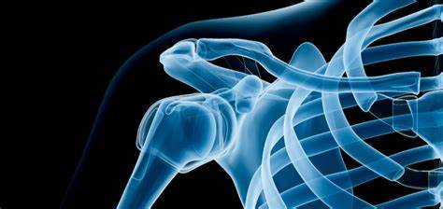
THEME- HEALTHCARE
TIME NAME-
CLOUDE HACKER

Slide 2
Team Details
Team Leader - Ayush Gupta
Team Members - Neeraj Lodhi
Vinit Sheetal
Nikshay Yadav

Slide 3
Problem Statement
An AI-based diagnostic tool that can analyze medical images (e.g., X-rays, MRIs, CT scans) to assist doctors in detecting diseases like cancer, pneumonia, or fractures more accurately and swiftly.

Slide 4
Understanding the problems
Quickly processes and interprets medical images. This speed allows doctors to provide, timely diagnosis, which can be crucial in cases where early detection significantly impacts treatment outcomes.
01
The AI tool helps doctors by giving a second opinion or pointing out things that need more attention. It doesn't take the place of doctors, but it helps them make better decisions and give better care to patients.
02

Slide 5
Solution
Data Collection:
Gather a diverse set of high-quality medical images
representing various diseases.
Machine Learning Models:
Use algorithms like CNNs to detect disease patterns.
Annotation & Labeling:
Ensure expert-labeled data for supervised learning.
Validation & Testing:
Rigorously test the tool’s accuracy against expert radiologists.
Clinical Integration:
Seamlessly integrate the tool with healthcare workflows.
Regulatory Compliance:
Meet medical standards like FDA or CE approval.
User Interface:
Design an intuitive interface for easy interpretation by doctors.
Continuous Learning:
Implement feedback loops for ongoing model improvement.

Slide 6
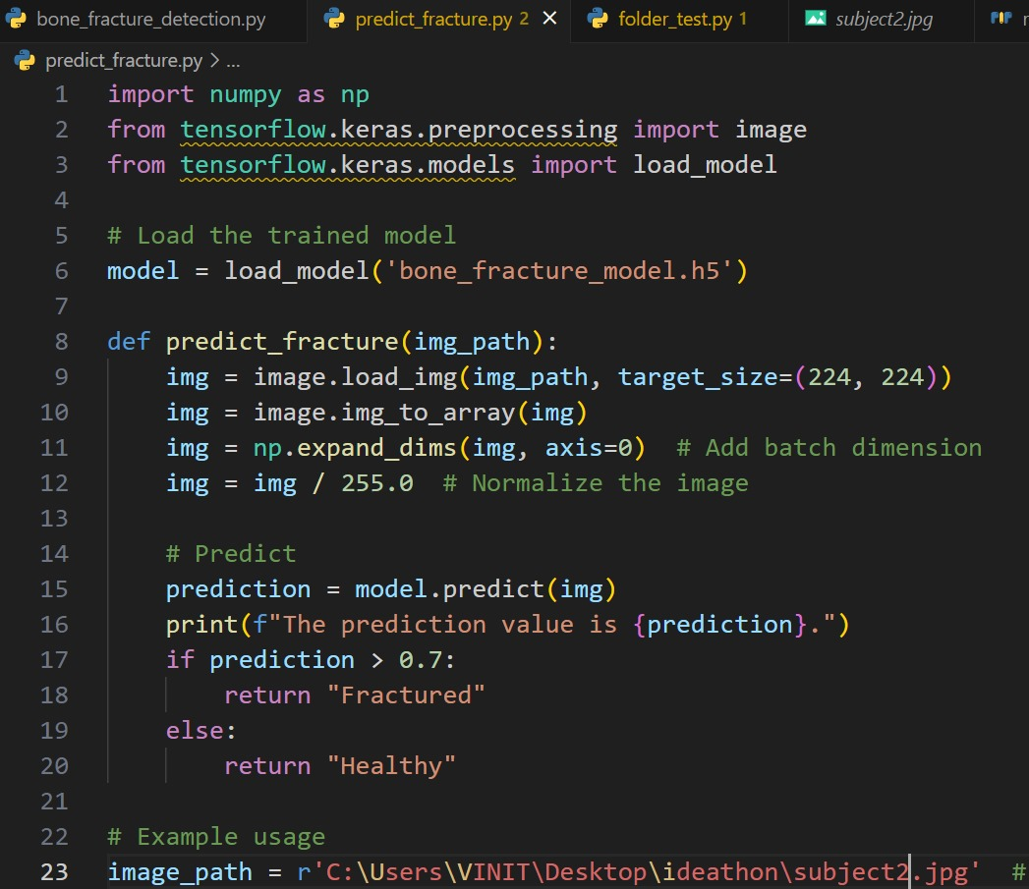
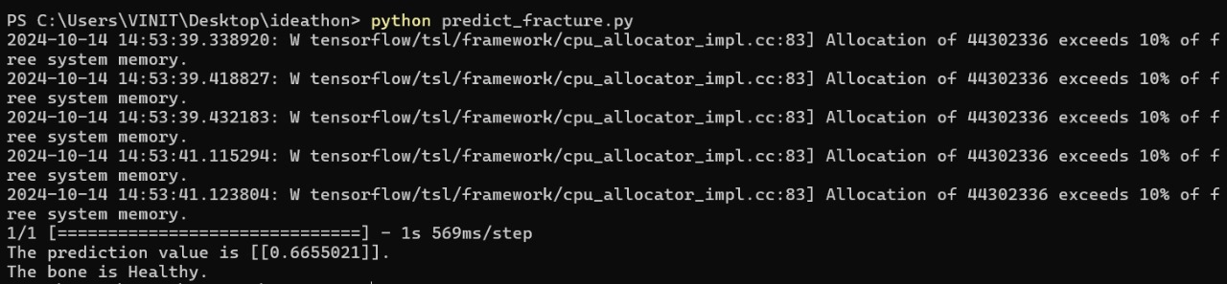
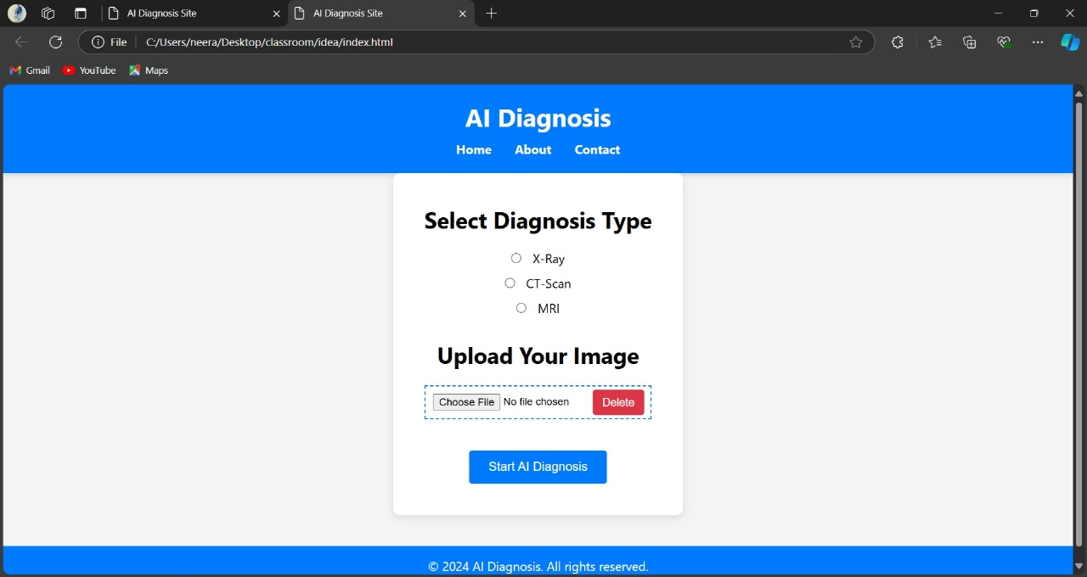
This code uses a pre-trained model to check if an image (like an X-ray) shows a broken bone. The image is prepared and then analyzed by the model. The result will either say 'Fractured' or 'Healthy,' depending on the score.

Slide 7
key Features of our Solution
Key Partners
04
Key Activities
Diagnostic Centers Hospitals with Radiology
AI Developments and Maintenance
Partnership Management
01
03
Value Propositions
Customer Relationships
Accuracy and Reliability Efficiency
02
Training and Education Dedicated Support

Slide 8

Thank you!

